Slide 1
HarvestGuard: Leaf Disease Classification
Presented By:
Lauren Taylor, Prachi Khanna, Ryan Laxamana

Slide 2
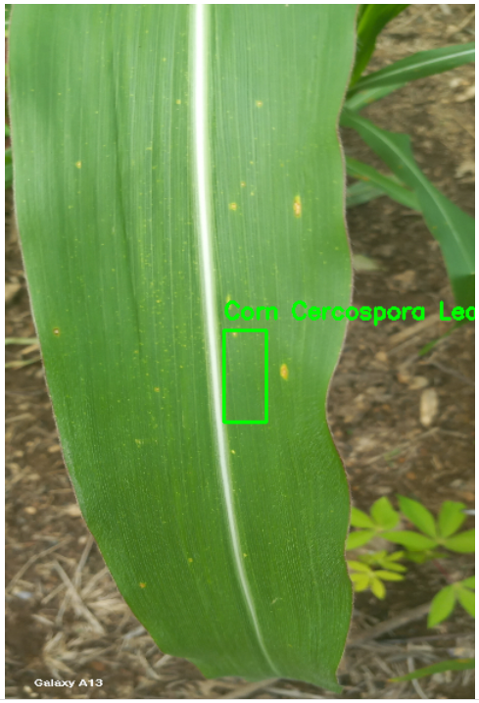
Introduction
Project Overview:
Multi-class object detection and bounding box regression system
Aims to identify classes of diseases on leaves and draw bounding boxes on affected areas.
Crop Disease (Ghana) Dataset is used to design the system.
Why is this problem important?
Crop disease contributes to economic loss and hunger globally.
Dynamic issue that is always evolving.
Need for novel solutions to identify and monitor issues

Slide 3
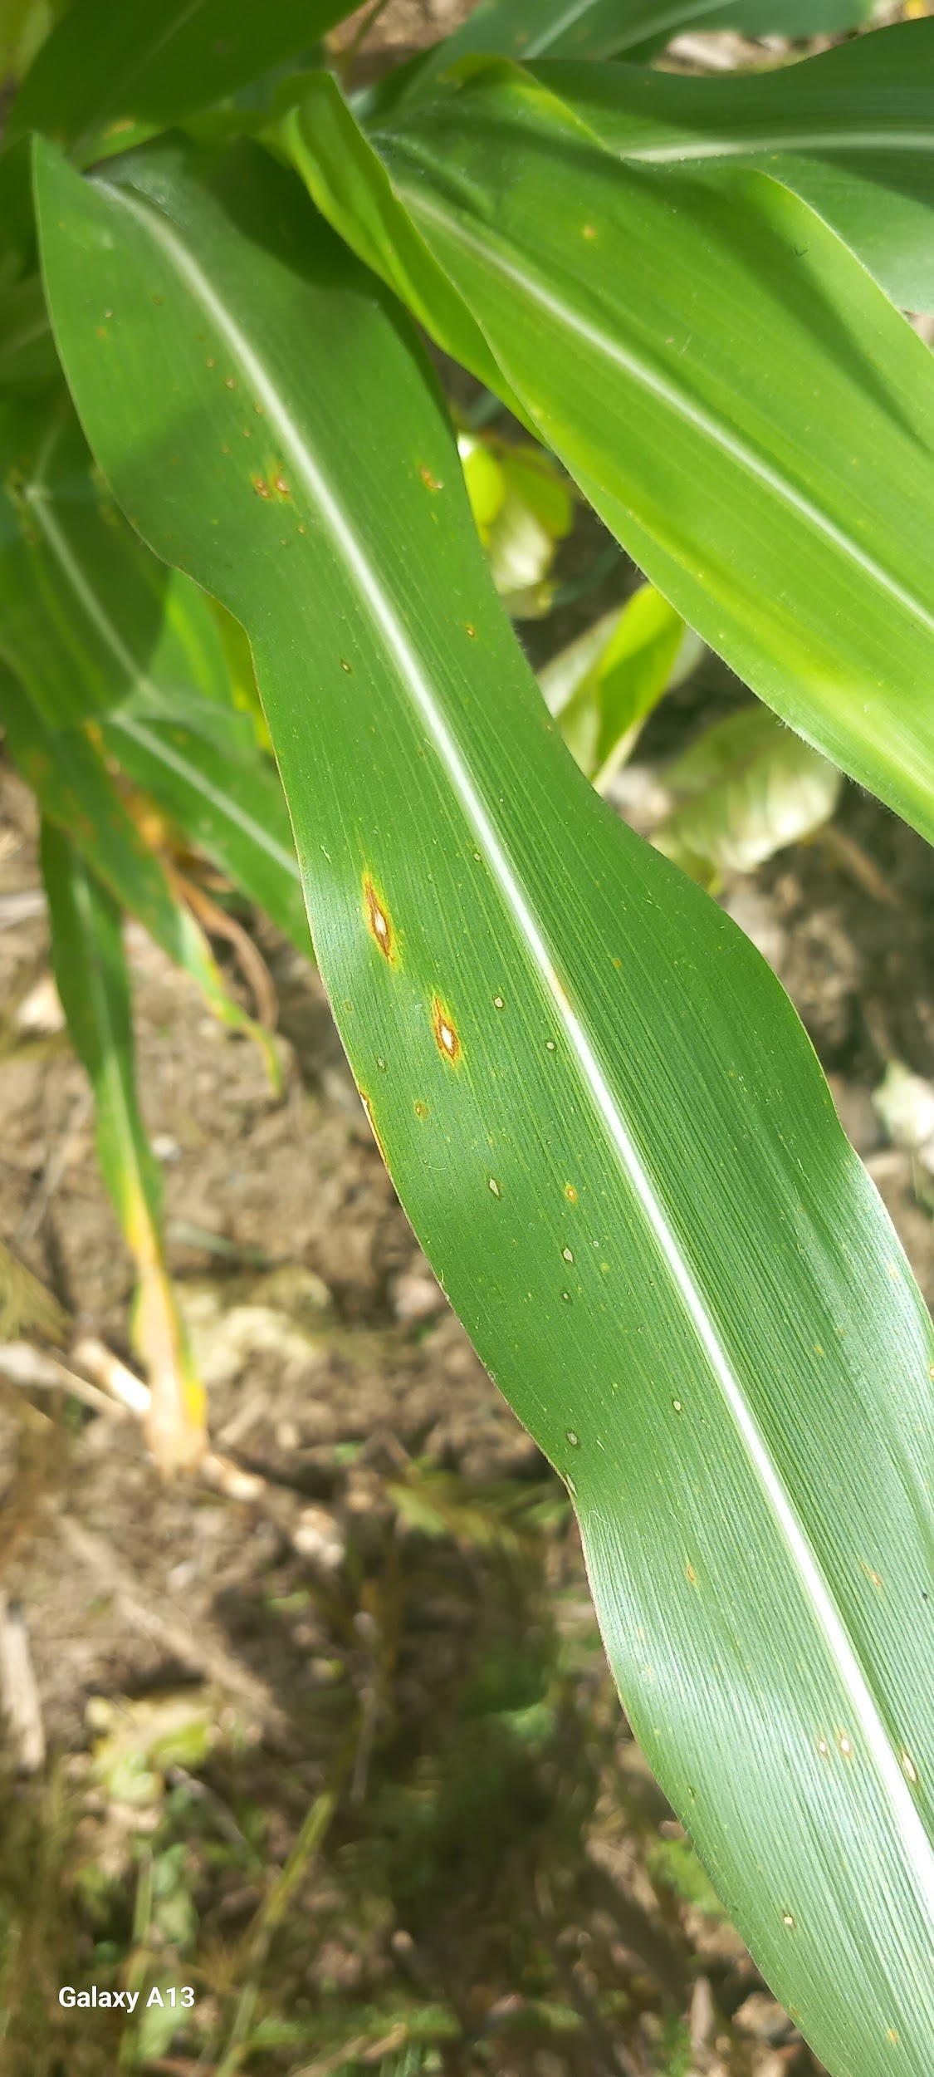
The Dataset
Afrocentric (African) Crop Dataset:
The dataset was created and published by a research group at Kwame Nkrumah University of Science and Technology in Ghana
3 crop types: (tomato,pepper, and corn)
Includes instances of various diseases, along with healthy specimens.
Annotations: XML files with coordinates of bounding boxes encompassing diseased areas

Slide 4
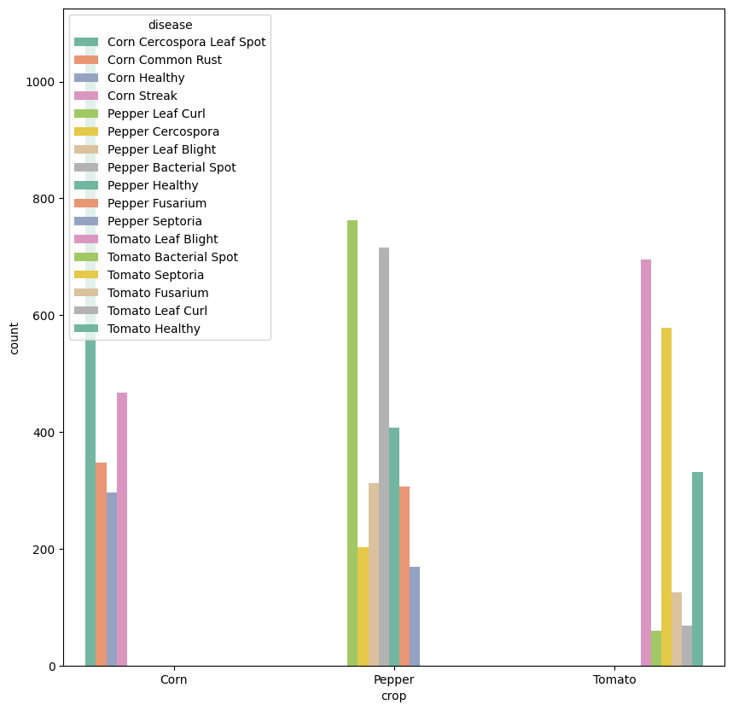
EDA/Data Augmentation
Imbalanced distribution of disease classes.
Can cause model to be biased towards more common classes.
Addressing Imbalance:
Merge similar classes, (eg. late blight and early blight→ blight)
Undersampling majority classes.
Data augmentation: Flipping, roating, blurring, adding noise to images

Slide 5
Multi-class object detection and bounding box regression
A State-of-the-Art Pretrained Language Model:
VGG16 is object detection and classification algorithm which is able to classify with 92.7% accuracy. It is one of the popular algorithms for image classification and is easy to use with transfer learning.
A Compact and Efficient Iteration of VGG16:
VGG16 network is loaded with weights pre-trained on the ImageNet dataset. We leave off the fully-connected layer head , freeze the body such that weight will not be updates during fine tuning and flatten the output of the network
We created a new layer head responsible for multi-output prediction (i.e., class label and bounding box location).
Fine-Tuned on the Afrocentric (African) Crop Dataset:
By training on images of crops with various diseases and annotations, HarvestGuard becomes an expert in identifying classes of disease on leaves and bounding box on it.

Slide 6
HarvestGuard Overall Architecture
Data Processing
Training Loop
EDA
Training Arguments
Fine Tuned Multi-Class Model
Results Prediction
Afrocentric Crop Dataset
Image Dataset Augmentation
Trainer
Images and bounding boxes resizing
Evaluation

Slide 7
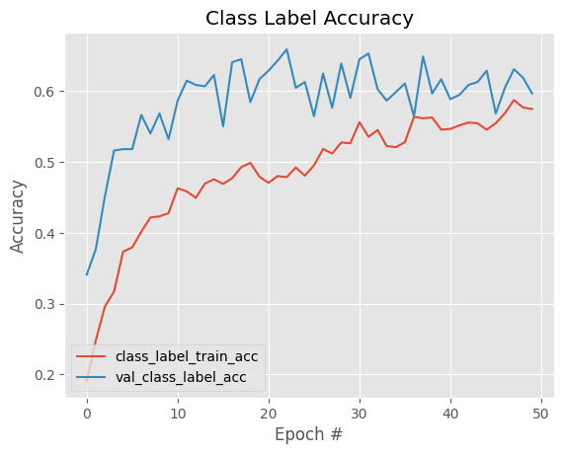
The Results-Classification Model
Metric | Value
Accuracy | 59.7%
Precision (Micro) | 63.9%
Recall (Micro) | 59.7%
F1 Score (Micro) | 59.7%
Higher Precision, lower recall →slight tendency towards false negatives
Evidence of model under fitting

Slide 8
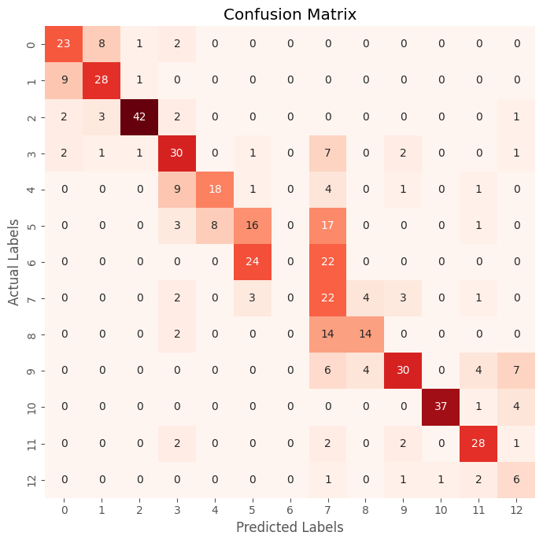
The Results-Confusion Matrix
Best Category:
Worst Category:

Slide 9
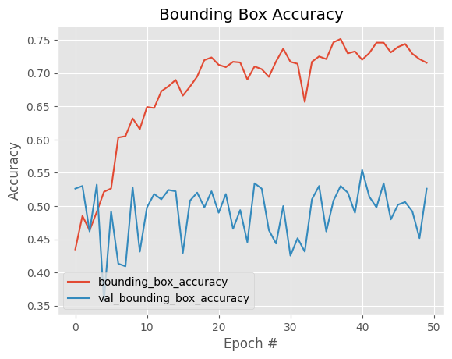
The Results-Bounding Boxes
Metric | Value
Accuracy | 52.62%
Mean Squared Error | 6.53%
Evidence of model overfitting
Instability in validation performance

Slide 10
Future Directions
Dataset concerns:
Increase data set size by collecting more photos, ensuring categorical balance.
Feature Extraction:
Research architectures that can better extract subtle differences within crop types.
Regional Functionality Enhancement:
Consider souring crop samples from other regions to improve regional performance.
Explore transfer learning opportunities.
Deployment Considerations:
How to scale model to enable efficient processing of large volumes of data.
Integrating the model into existing farming systems.
Updating system as problem evolves and new knowledge becomes available.

Slide 11
Individual Contributions
Lauren:
Data Preprocessing
Data augmentation
Writing report
Creating slides
Prachi:
Design model
Training model
Model evaluation
Creating slides
Writing report
Ryan:
XX
XX

